Slide 2
Technical Interviews
Presented by: Orion Supergan

Slide 3
About Orion
Software Engineer II at CDK Global for 12 password resets
Programming for 5+ years
Performed 30+ technical interviews
Algorithms are fun.

Slide 4
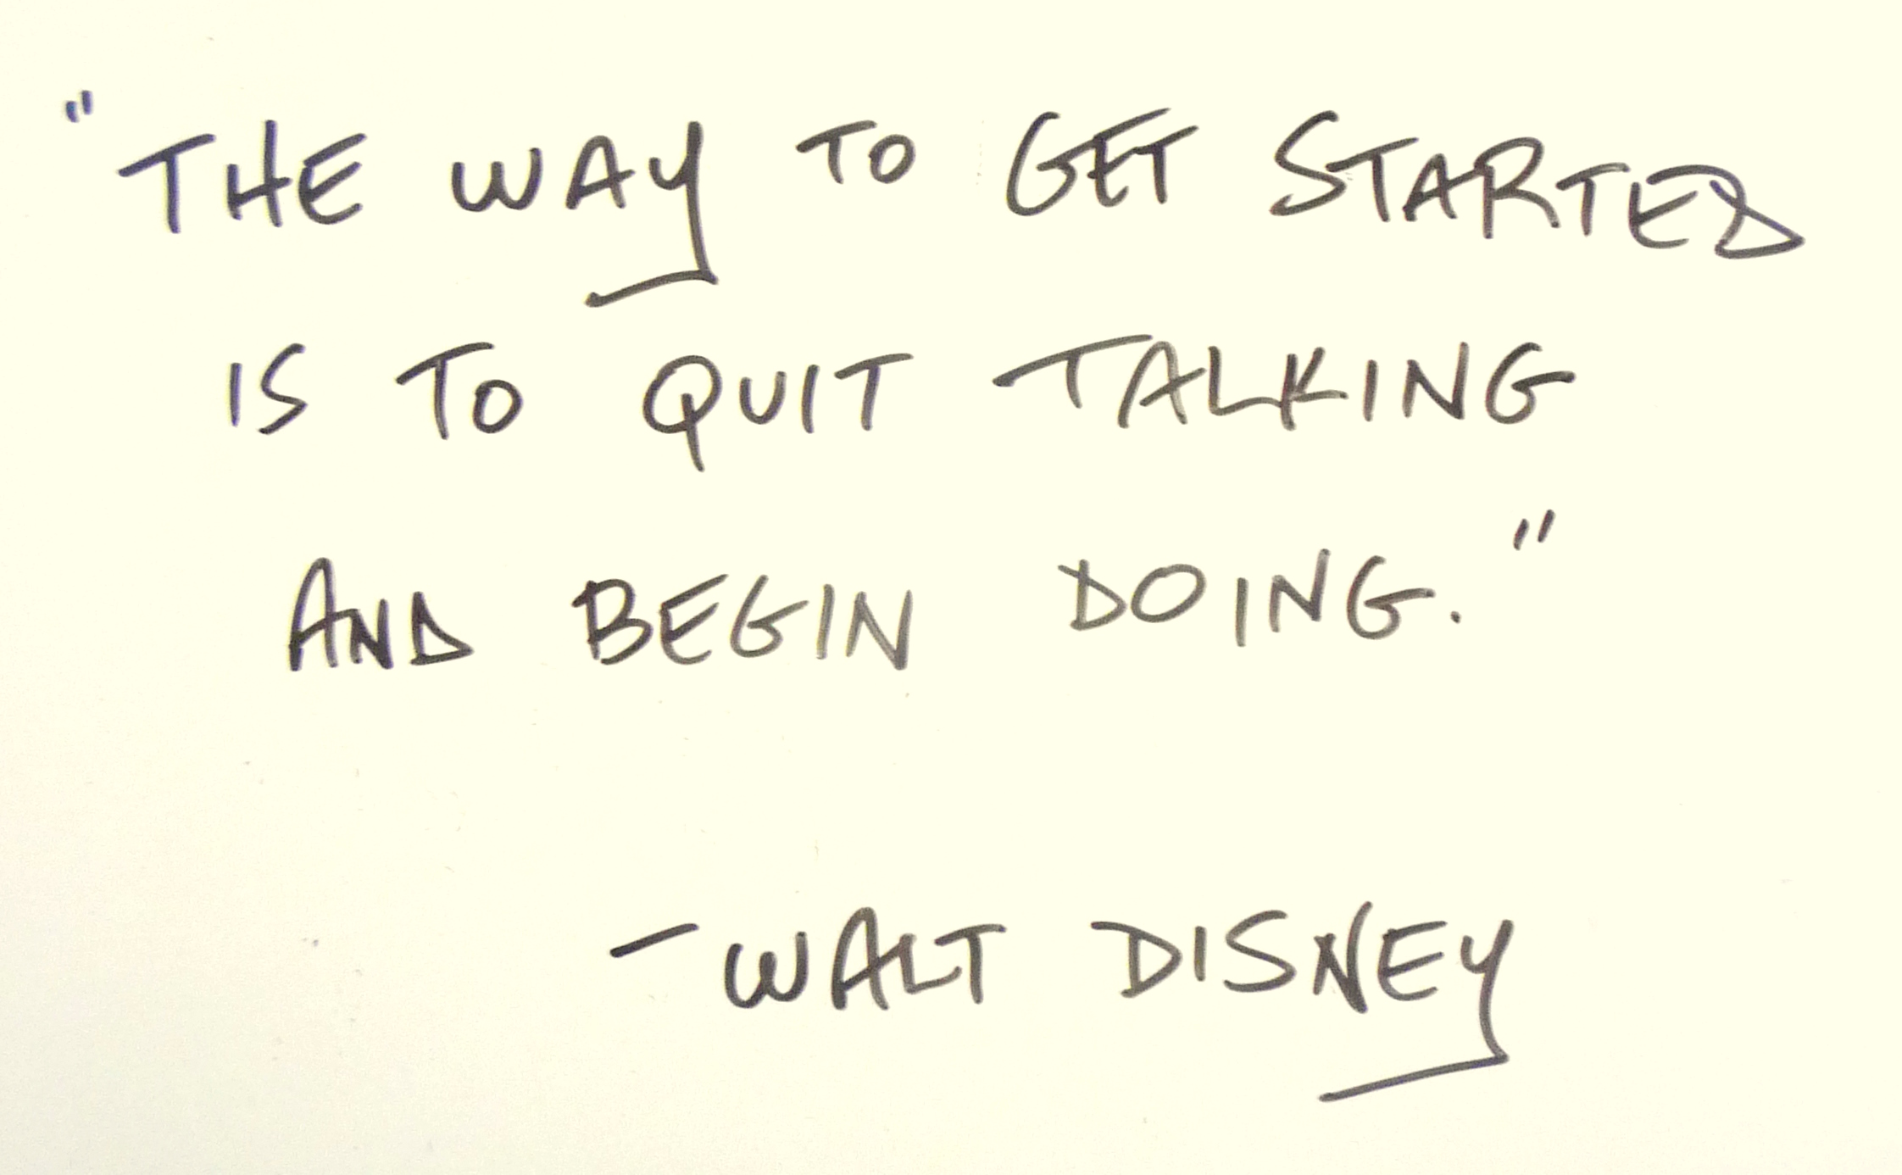
About Alisa
SEO Specialist II at CDK Global, on loan to DevCore Design Platform Planning team
Study/Career Path: Art to English to SEO to Coding
Currently studying: Bash, JavaScript.

Slide 5
Mock Technical Interview: FizzBuzz
Interview question: "Write a program that takes a number and prints it. But if the number is a multiple of three print “Fizz” and if the number is a multiple of five print “Buzz”. For numbers which are multiples of both three and five print “FizzBuzz”."

Slide 6
Audience Feedback
What went well?
What could have been improved?
Was there anything interesting that happened?

Slide 7
Software Engineer Interview Process
Pass HR qualifications (and hope they know the difference between Java and Javascript)
Phone/remote technical interview
On site full day interview.

Slide 8

Resume Thoughts
Notes:
Apply if you meet 25% of the qualifications
Any courses, including free online
Personal Projects
Github
25% is gender socialization, most men apply at this rate.

Slide 9
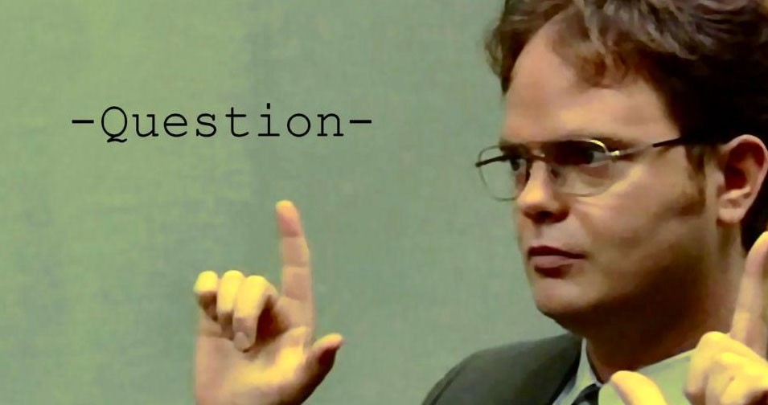
Tip 1: Ask Questions
Notes:
The coding exercise given is designed to see how you think.
The task is usually ambiguous in some way, dig for details.
A minimum of 3 questions before starting to code.
If you think of a new question after already having code down, ask right away. It’s better to refactor early.

Slide 10
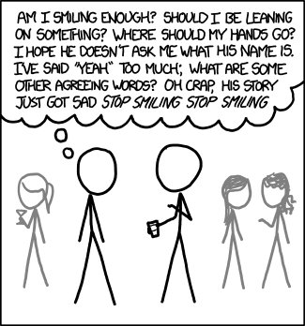
Tip 2: Say your thoughts out loud
Notes:
Thinking out loud helps the interviewer see your thought process
It has the added benefit of helping you see logical errors in code
How you approach a problem can be more important than getting working code

Slide 11
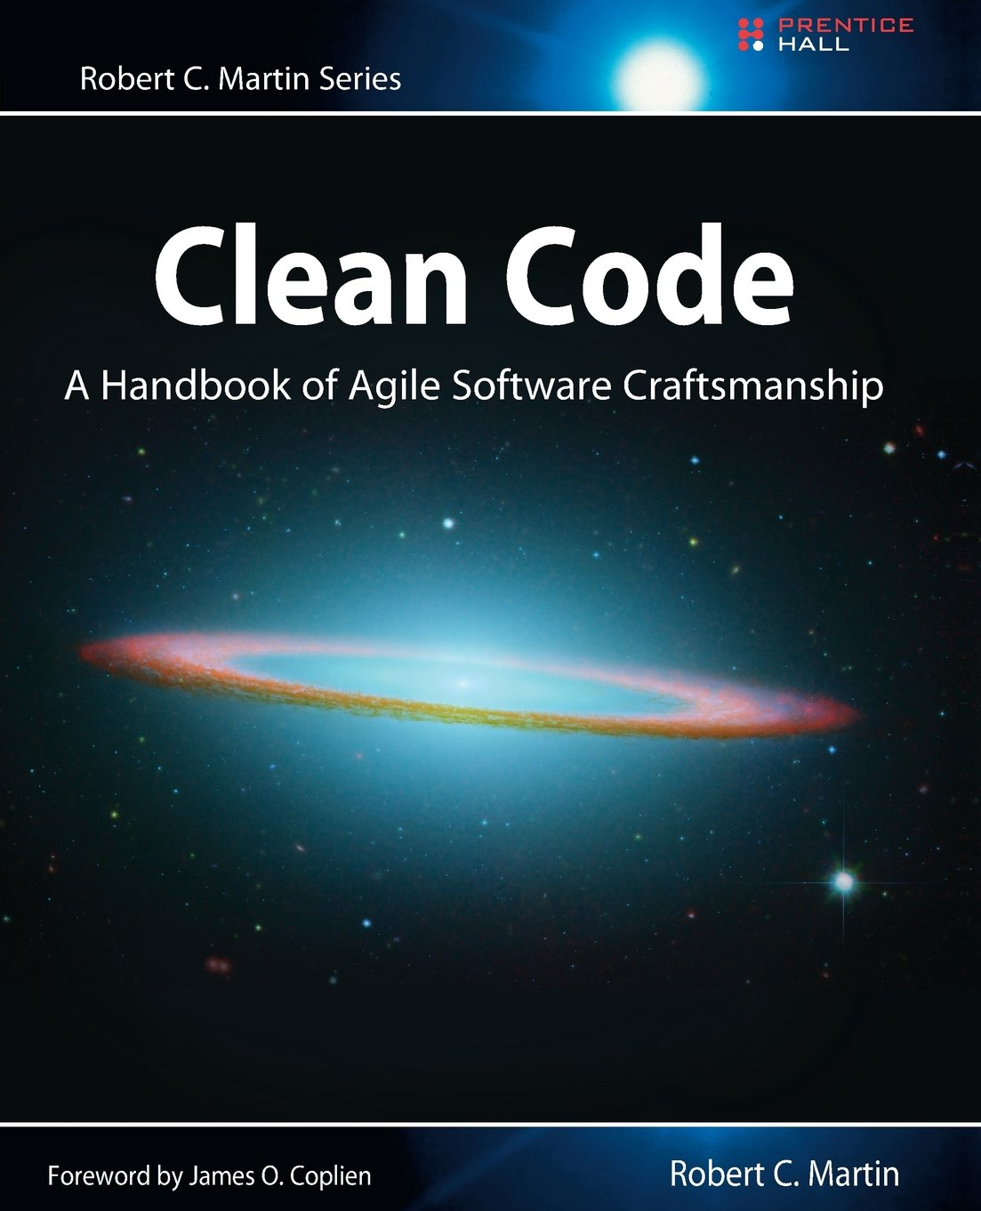
Tip 3: Write clean code
Notes:
Having production ready code in an interview is impressive.
After getting the basics of how to program down, invest time in learning common conventions.
Clean Code by Martin Fowler – Highly recommended.
Single Responsibility Principle – Every function does one thing

Slide 12
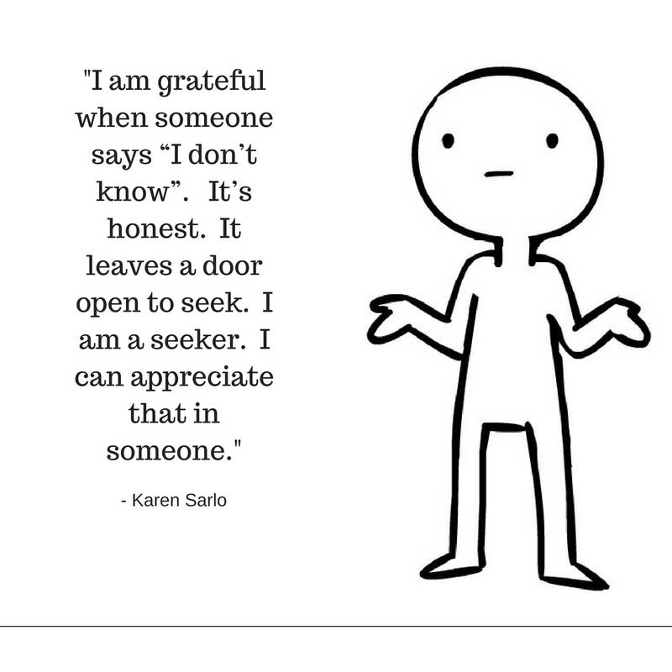
Tip 4: Be honest when you don’t know
Notes:
It is impossible to know everything
Saying you don’t know/understand can show you’re willing to seek clarity before taking on a task
Can show confidence in other knowledge. Ex: “I know there’s a way to convert from string to number, but I forget the command”

Slide 13
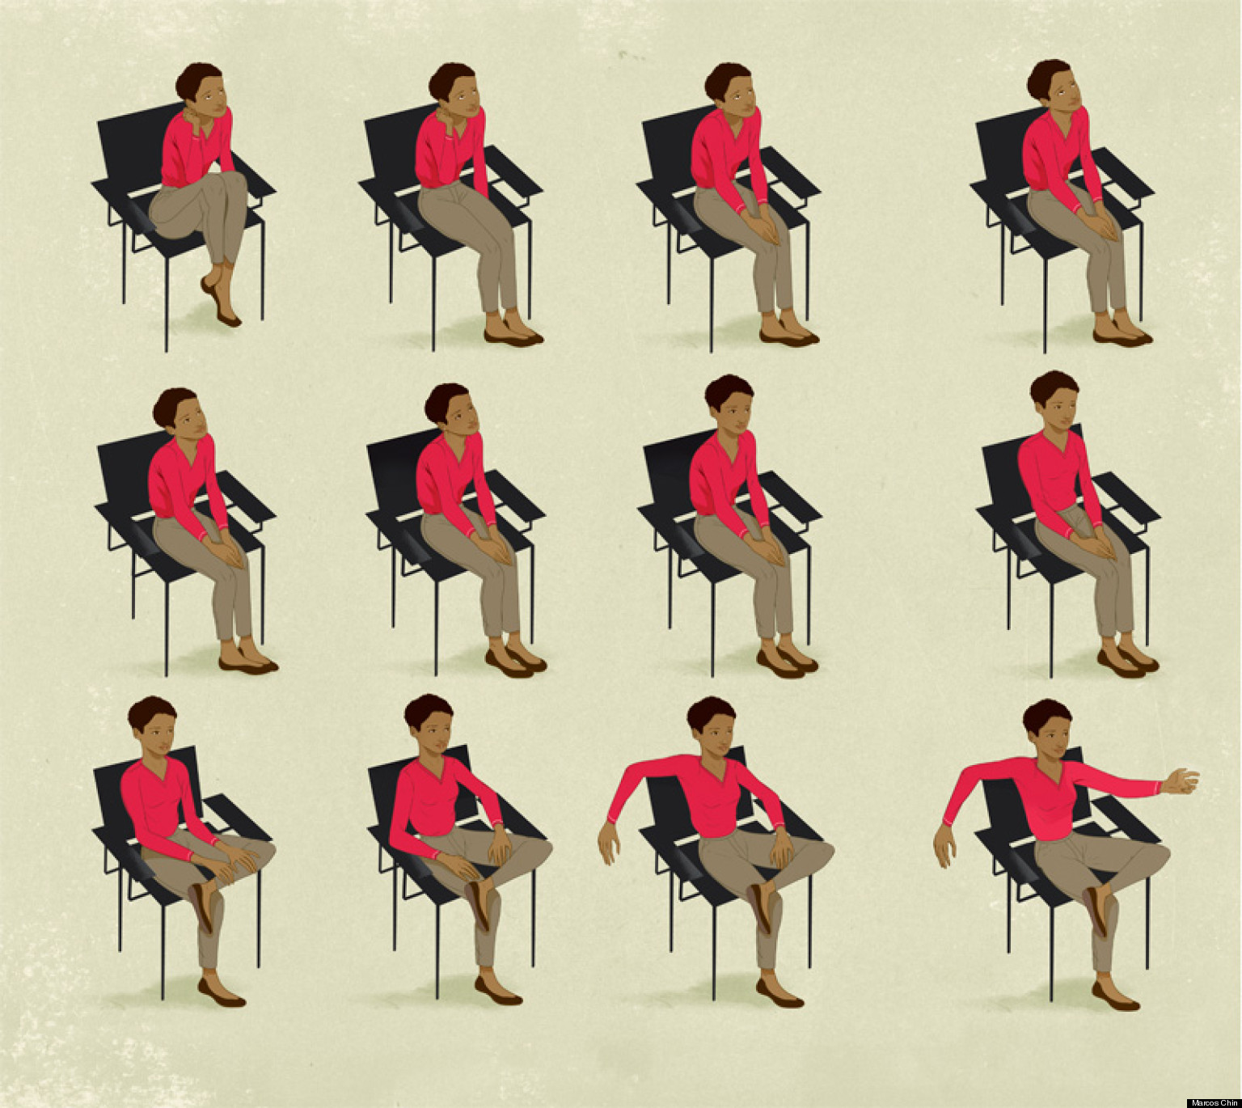
Tip 5: Use Body Language Tricks
Notes:
If you’re stumped, look up while thinking, not down
Open palms give the impression of being honest
Thumb and pointer finger together indicates knowledge
Mimic the other person’s posture
Avoid covering the mouth when talking
Match speech pace

Slide 14


Interpersonal Psychology: The Human Algorithm

Slide 15
Questions?
What happens if my code doesn’t work?
What helps an applicant stand out?
Is there anything I should avoid?
What is a common mistake you see?
Is there anything I should do after I’m done with the interview?

